Slide 1
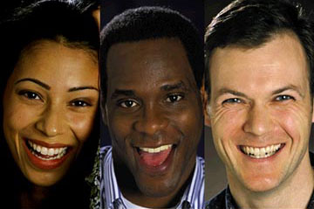
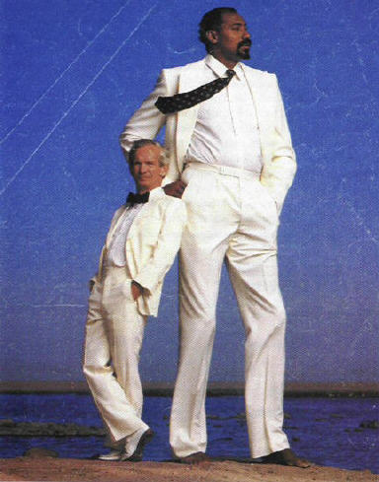
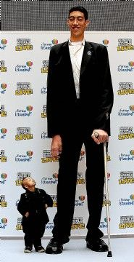
HUMAN
GENETICS

Slide 2
Introduction
  46 chromosomes in each cell (23 pairs)
  Autosomes: all chromosomes except sex chromosomes (22 pairs)
  Sex chromosomes: determine gender (1 pair)

Slide 4
Sex determination
  XX = female
  XY = male
During meiosis, each egg from the female gets an X; 1/2 male sperm get X, 1/2 get Y
Males determine gender of offspring!
  Except in birds and reptiles where female is XY and male is XX

Slide 5
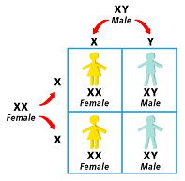

Slide 6
Studying human genetics
  Difficult because
    Long generations (25 yrs)
    Single births
    Ethical concerns

Slide 7
Methods for studying humans
  Pedigrees: record that shows how a trait is inherited within a family

Slide 8
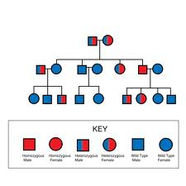

Slide 9
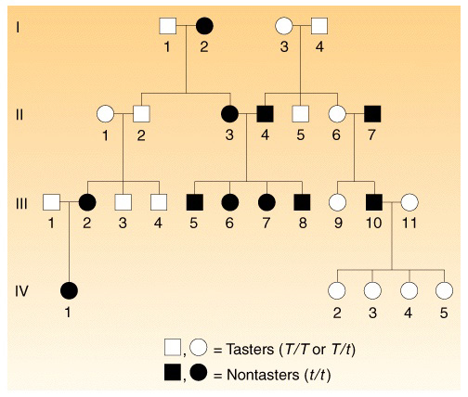

Slide 10
Population sampling
  Selecting a small # of people to represent an entire population
  Must be a random sample
  Ex: through random sampling, researchers discovered that 65% of people in US taste PTC, 35% cannot

Slide 11
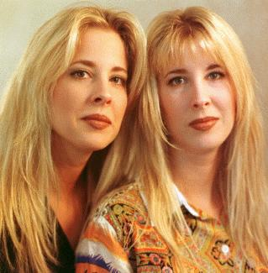
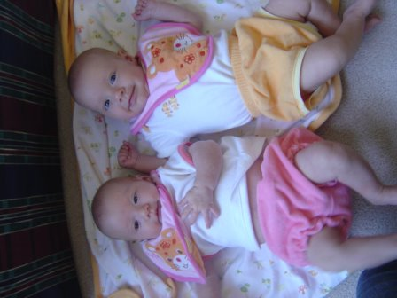
Identical twin studies
  Identical genetic codes
  Separated at birth: study which traits are genetic(Nature) & which are environmental (Nurture)

Slide 12
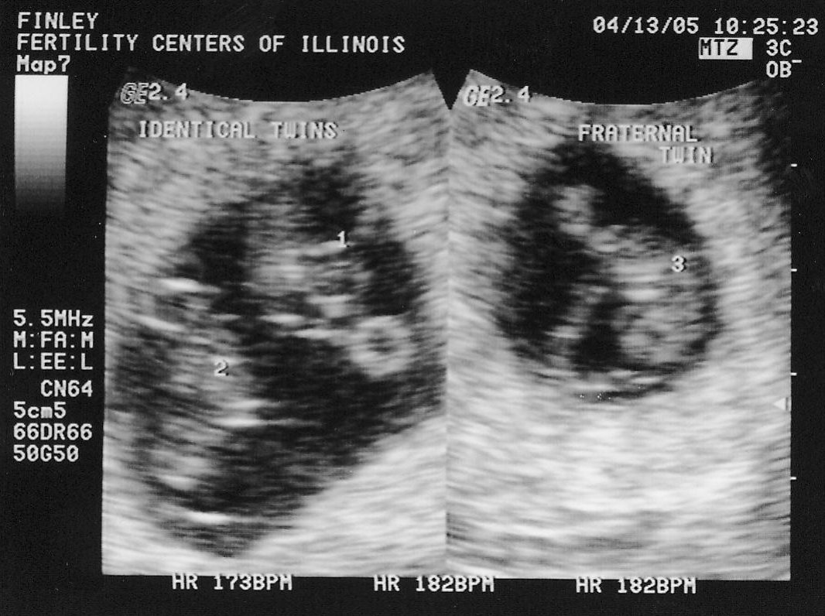

Slide 13
Inheritance of human traits
  Dominant traits
    Polydactyly - extra fingers & toes
    Dwarfism - small size
    Curly hair
    Huntington disease - nervous disorder
    Piebaldness - white patches of hair

Slide 14
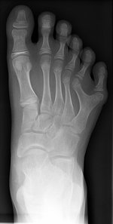

Slide 15
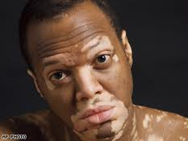

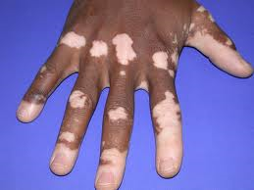
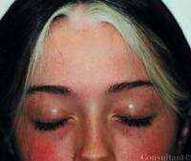
Piebaldness=Genetic
Vitiligo=AutoImmune

Slide 16
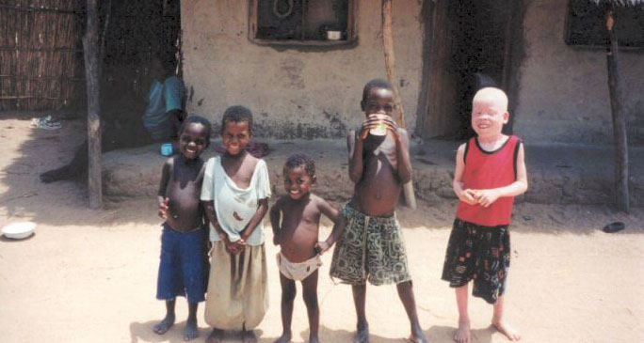
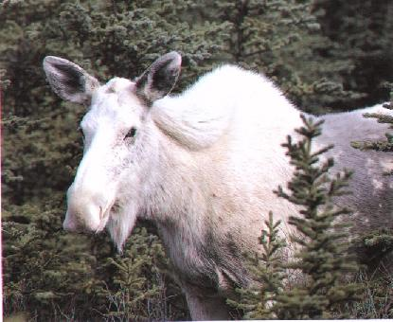
Recessive traits
  Straight hair
  Freckles
  Albino
  Cystic fibrosis - lung disorder
  Deafness
  PKU - nervous disorder

Slide 17
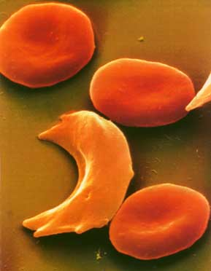
Codominance
  Sickle cell anemia - irregularly shaped red blood cells
    O allele = healthy(HH)
    1 allele = mild case(HS), resistant to malaria
    2 alleles =
    severe case(SS)

Slide 18
Multiple alleles
  3 or more alleles which code for a single trait
  Human blood type
    3 possible alleles: I^{A}, I^{B}, i^{O}
    I^{A} & I^{B} are codominant, i^{O} is recessive
    41% of US is Type O -- o allele is most common

Slide 19
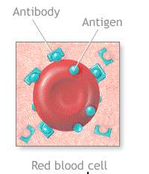
Possible blood types
Blood Type | Genotypes | Antigens
A | I^{A}I^{A} I^{A}i^{O} | A
B | I^{B}I^{B} I^{B}i^{O} | B
AB | I^{A}I^{B} | A & B | Universal acceptor
O | i^{O}i^{O} | None | Universal donor

Slide 20
Example punnet squares for type A dad and type B mom

Slide 21
Polygenic traits
  Controlled by 2 or more genes
  Skin color - the more genes, the more melanin → darker skin color
  Height - more dominant alleles → taller
  Eye Color

Slide 22
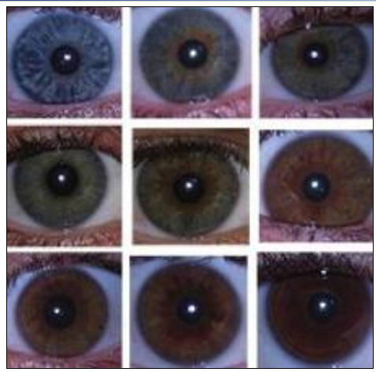
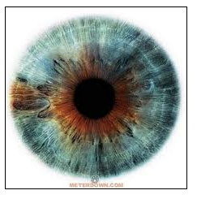

Slide 23
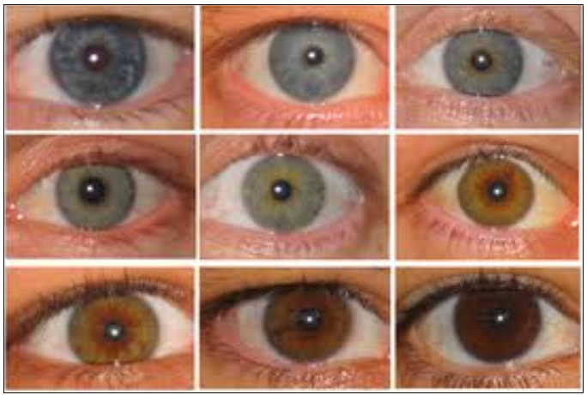

Slide 24
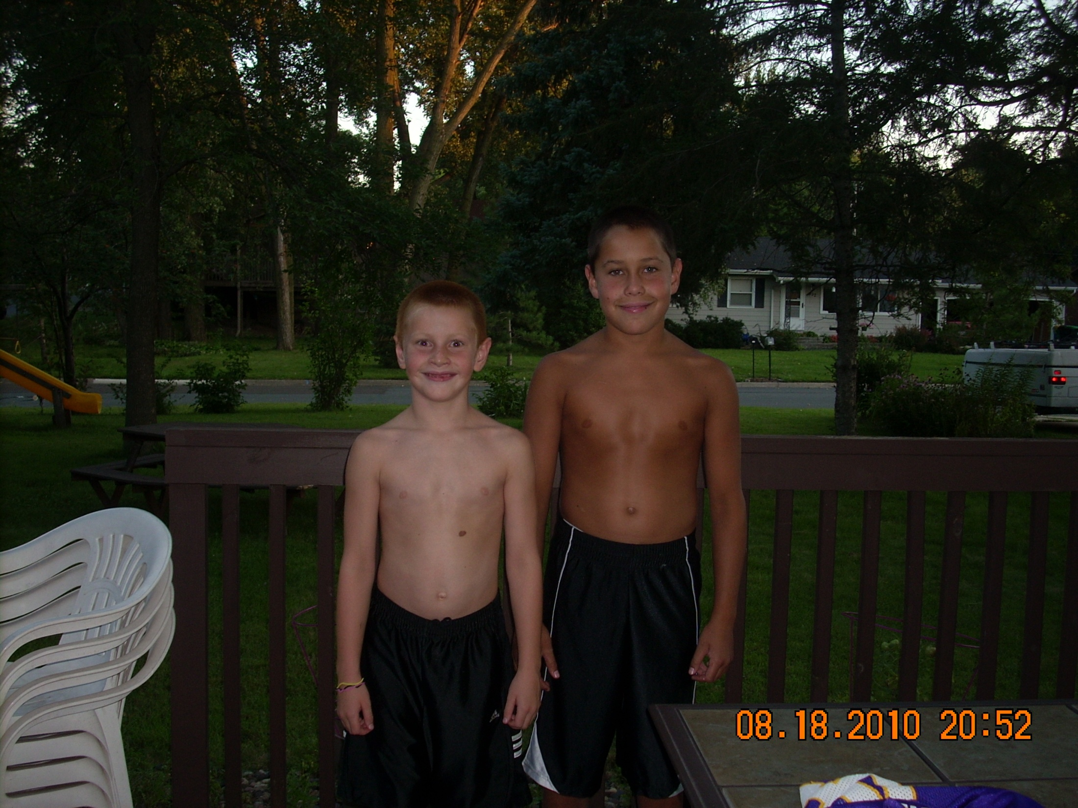

Slide 25
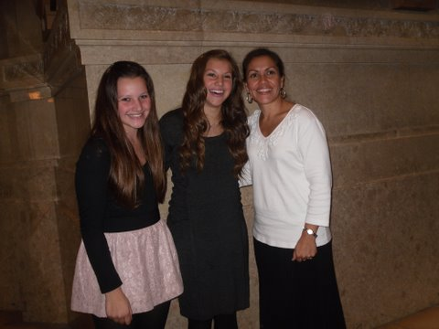

Slide 26
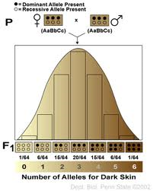
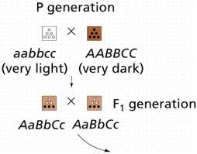

Slide 27
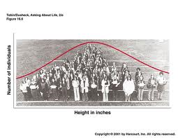

Slide 28
Sex-linked traits
  Genes located on X chromosome
  Males only have one X, so only have one allele controlling these genes
  Males more likely to have disorders that are sex-linked because they only need 1 recessive allele

Slide 30
  Carrier: someone who has one allele for a disorder -- does not have the disease but can pass it on to children
  Only women can be carriers for sex-linked traits
  Examples: hemophilia, muscular dystrophy, colorblindness

Slide 31
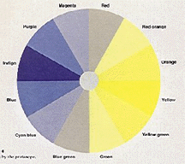
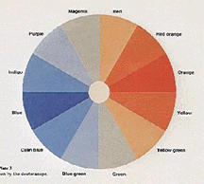
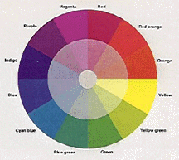
Color vision
  X^{C}=Color Vision, X^{c}=colorblind
  Males - 8% colorblind (X^{c}Y)
  Females - 1% colorblind (X^{c}X^{c})
Red-Green
Total
Normal

Slide 32
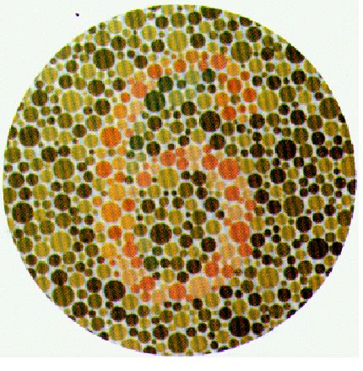

Slide 33
What are the chances for a healthy dad and a mom who is a carrier for colorblindness to have a child that is colorblind?

Slide 34
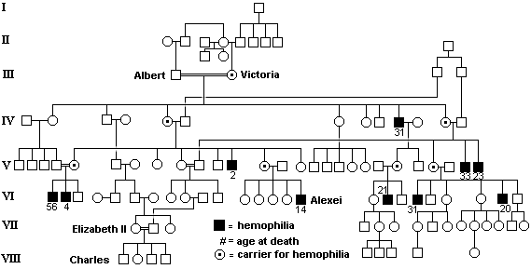
Hemophilia in the
Royal Families of Europe

Slide 35
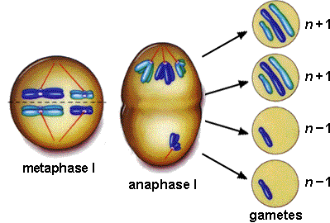
Genetic disorders
  Nondisjunction: failure of chromosomes to separate during meiosis
    Normal = 23 chromosomes
    Abnormal = 22 or 24

Slide 36
Monosomy: too few chromosomes, one chromosome left unpaired
  Turner syndrome: female with only 1 X chromosome
  Short stature, sterile

Slide 37
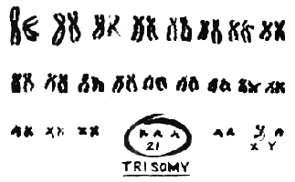
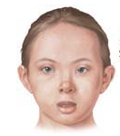
Trisomy: too many chromosomes, extra copy of one
  Down’s syndrome: trisomy 21
  1 in 1400 when mother under age 25, 1 in 100 by age 40

Slide 38
Detecting genetic disorders
  Physical characteristics - features, disabilities
  Ultrasound - pictures of baby in utero using sound waves
  Amniocentesis - sample of fluid from around baby, can examine baby’s cells
  http://www.biology.iupui.edu/biocourses/n100/2k4csomaldisordersnotes.html

Slide 39
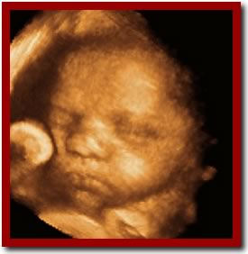
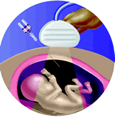
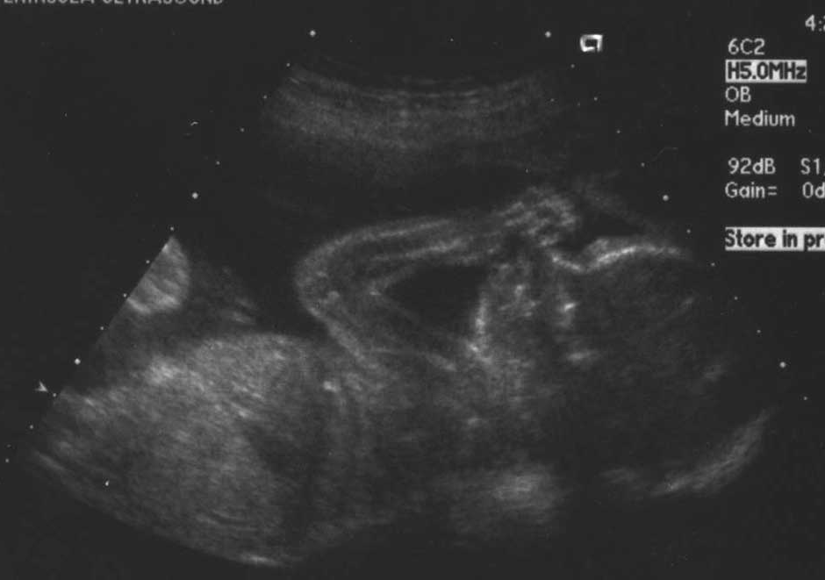
http://www.katie.com/babyblog/archives/000538.html

Slide 40
Karyotype: picture of a person’s cromosomes
  taken from any cells -- blood in adults, amnio for baby
Normal
Trisomy 21

Slide 41
Biotechnology
  Genetic engineering: manipulating the DNA of an organism
    Select useful traits, such as resistance to diseases
    Transgenic organisms: contain a gene from another organism

Slide 42
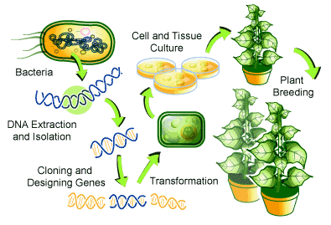

Slide 43
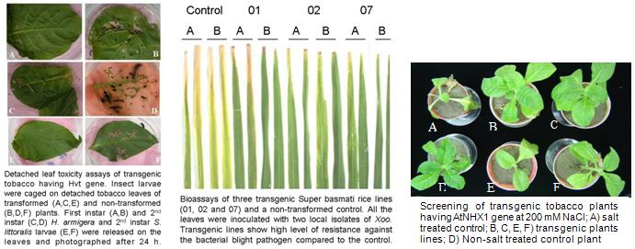

Slide 44
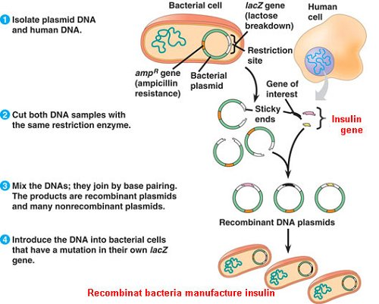

Slide 45
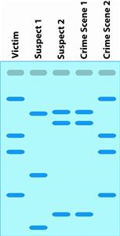
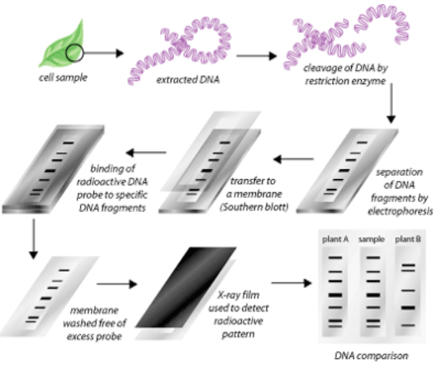
DNA fingerprinting
  Analysis of DNA sequences to determine identity

Slide 46
C.Gene therapy
  Once we know which genes code for specific proteins and cause disorders
  Insert a normal gene into a chromosome to replace a dysfunctional gene
  On hold until more research can be completed

Slide 47
